Slide 1

The DVK
Review Food
Here is where your presentation begins

Slide 2
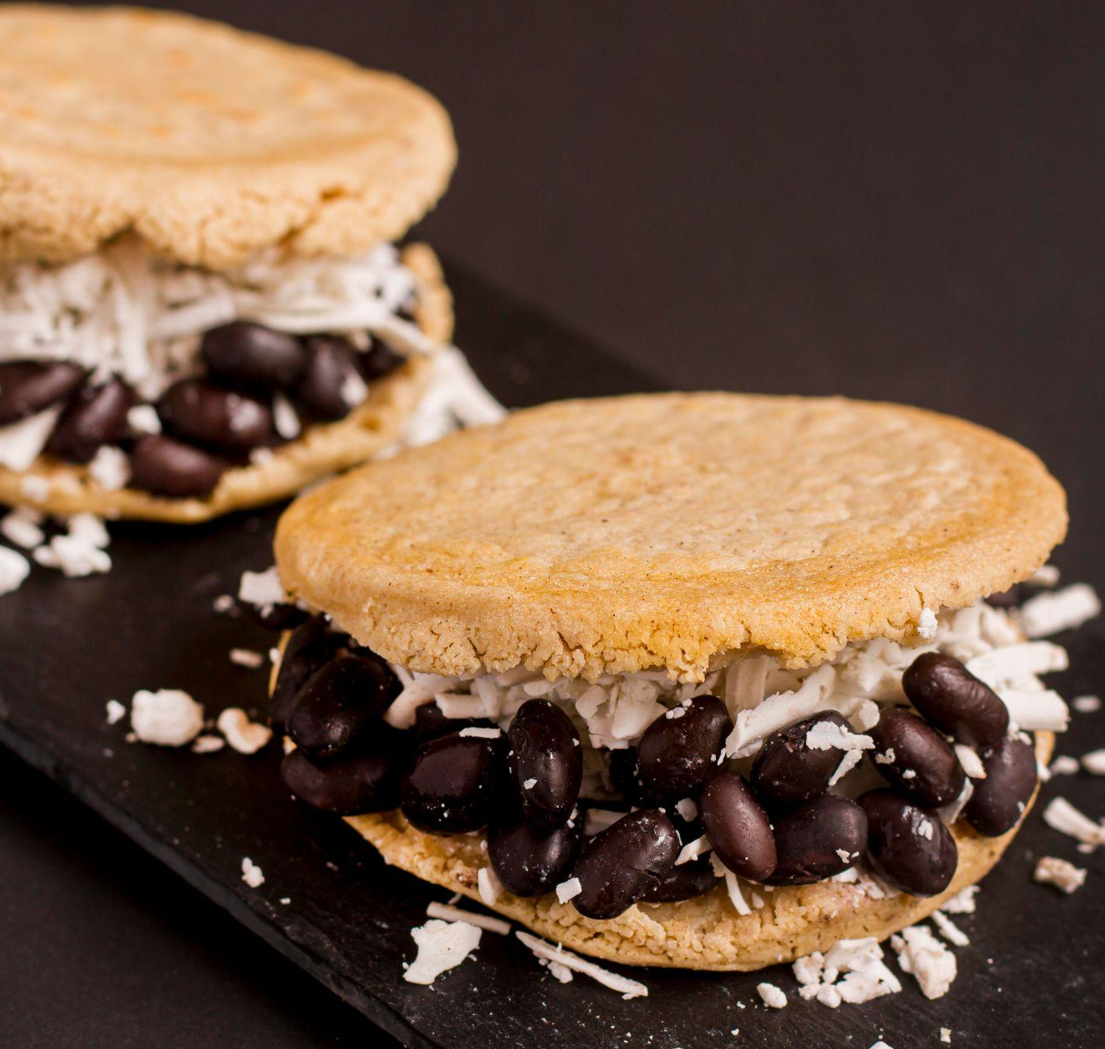
ABOUT DVK
Hà Thị Phương Thảo - SE161620
Bùi Thanh Tâm - SE161754
Hồ Như Ngọc - SE161750
Nguyễn Thị Minh Nguyệt - SE161788
Trần Thị Kim Ngân - SE161483

Slide 3

CONTENT
INTRODUCTION
Market analysis
01
03
02
Proposal
04
Benefits
02

Slide 4

INTRODUCTION
Quality
Service
Safe
Assured
No expensive

Slide 5
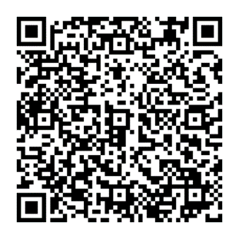
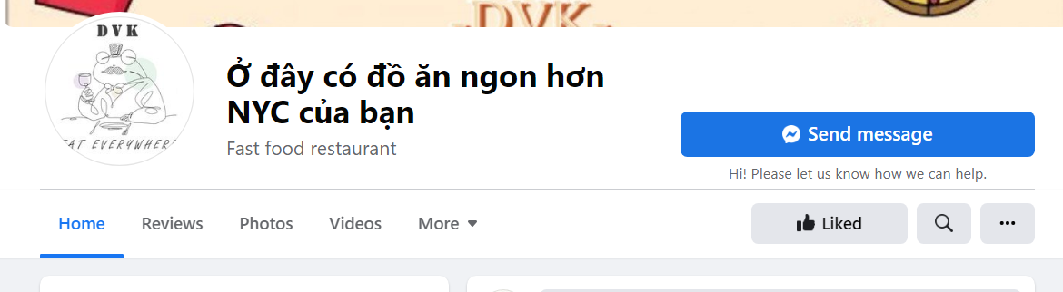

Slide 6
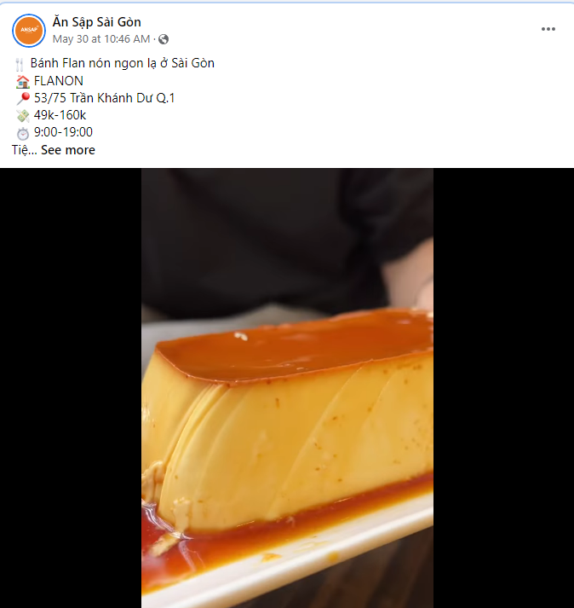
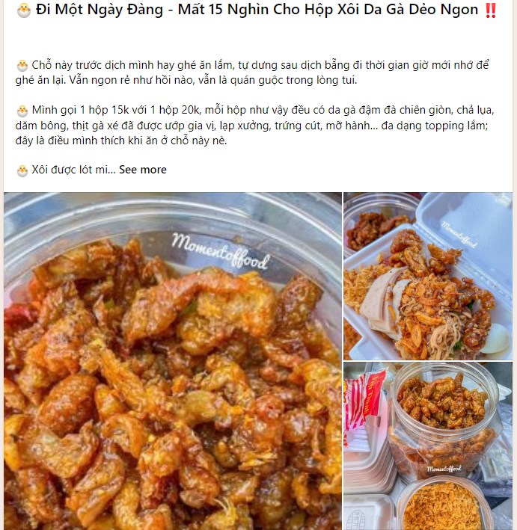
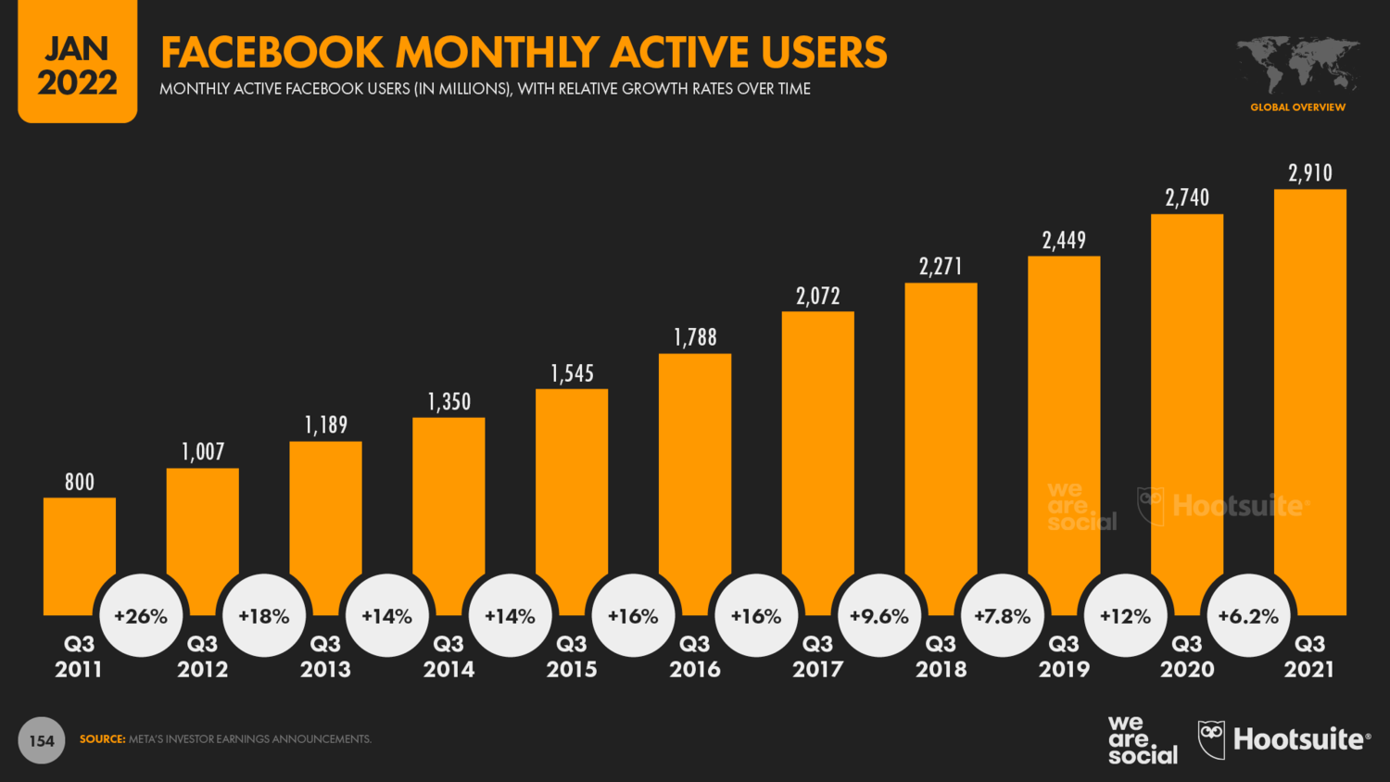
Background

Slide 7
Proposal

Slide 8
Market analysis

Slide 9

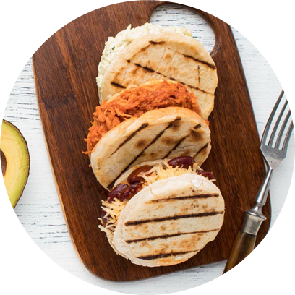
Benefits
Decide to choose the right product or service.
Look up information quickly.
Meet your own needs and desires Long term benefits:
Find your favorite food/restaurant.
Bring a new experience to customers real and natural experience.

Slide 10

Thanks for watching

Slide 11
TImeLine
No. | Work | Who | Deadline | Note
1 | Dicuss idea project | All of team | 3/6 | Logo, logan, direction projection,…..
2 | Create Logo | Ngọc | 6/6 | Change 7/6
3 | Building page on Facebook | Tâm and Nguyệt | 8/6
4 | Proposal | All of team
5 | Sustentive page | All of team | …..

